Slide 1
Videobooth
Language Resource Center Noyes Lodge
Erick Palma

Slide 2


1. User loads app
*** Notice: Any background can be used. ***

Slide 3




2. Fade in/Fade Out
[Fade in]
[Pause]
[Fade out]

Slide 4
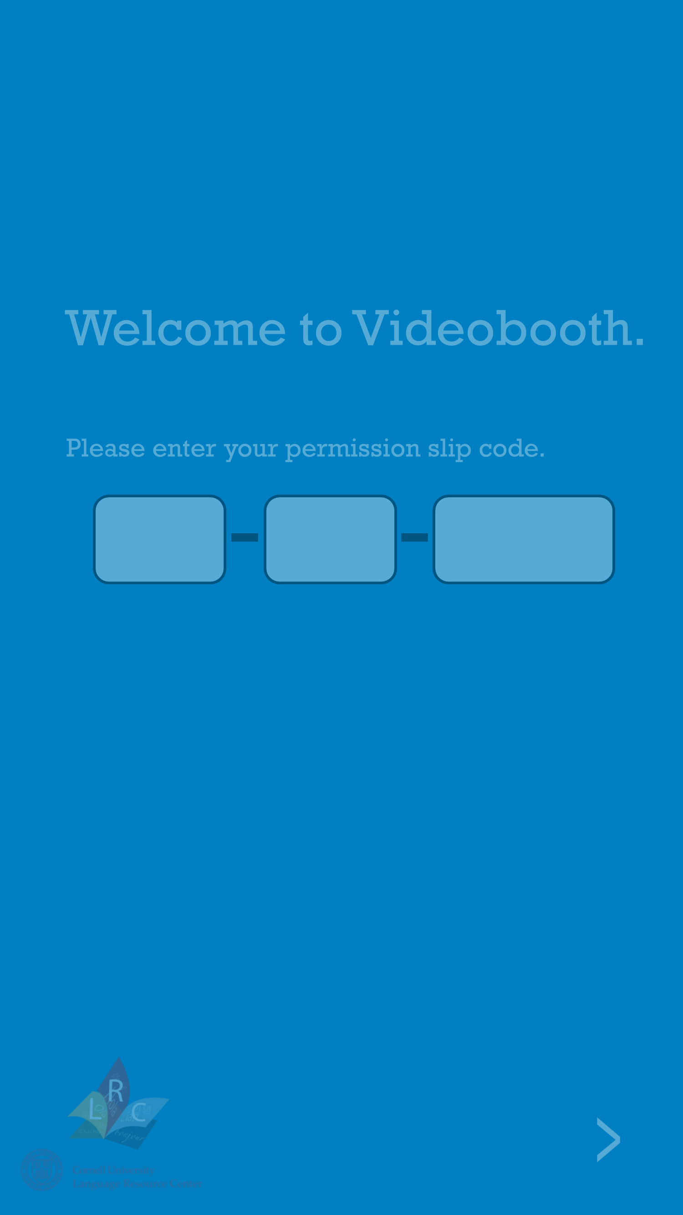
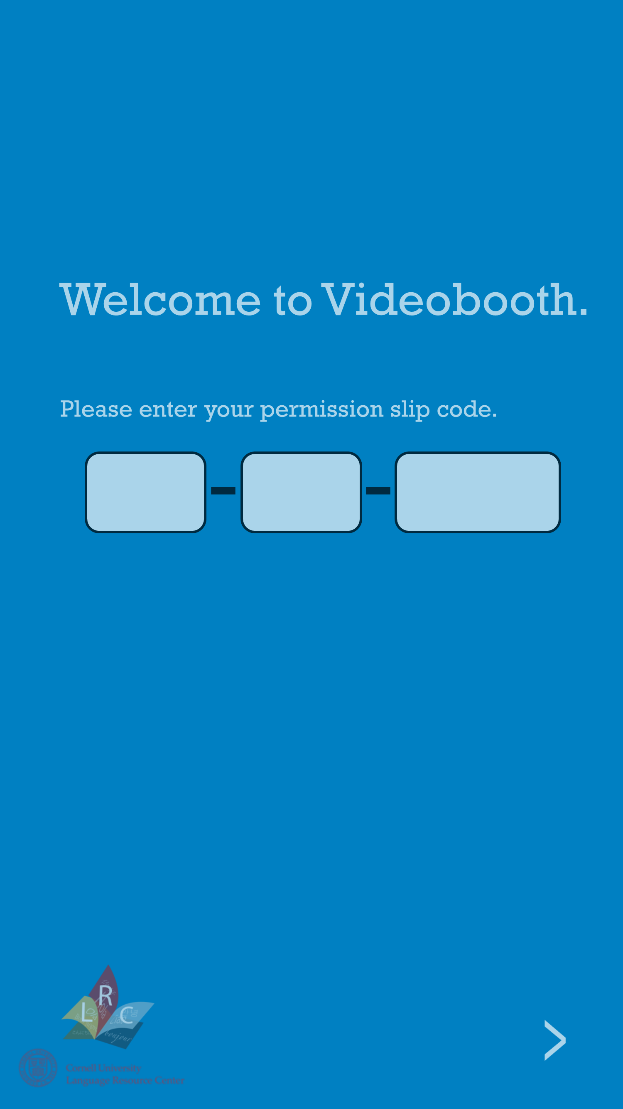
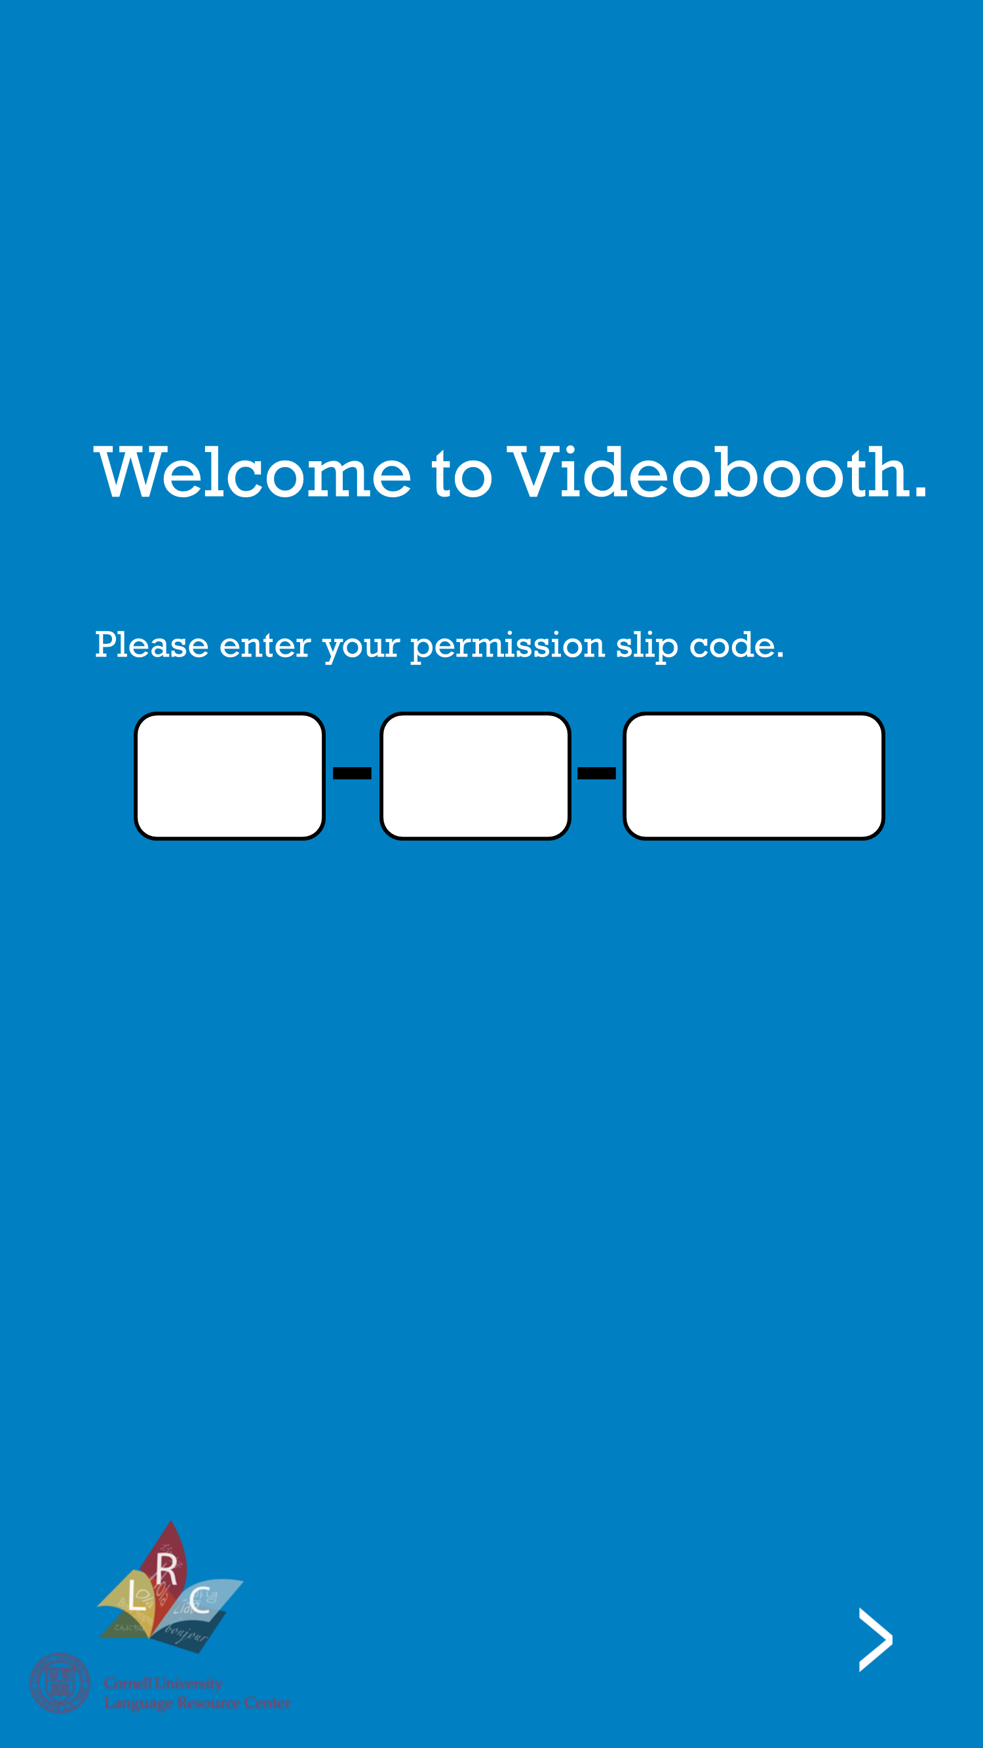
3. Fade in Boxes
[Fade in]

Slide 5
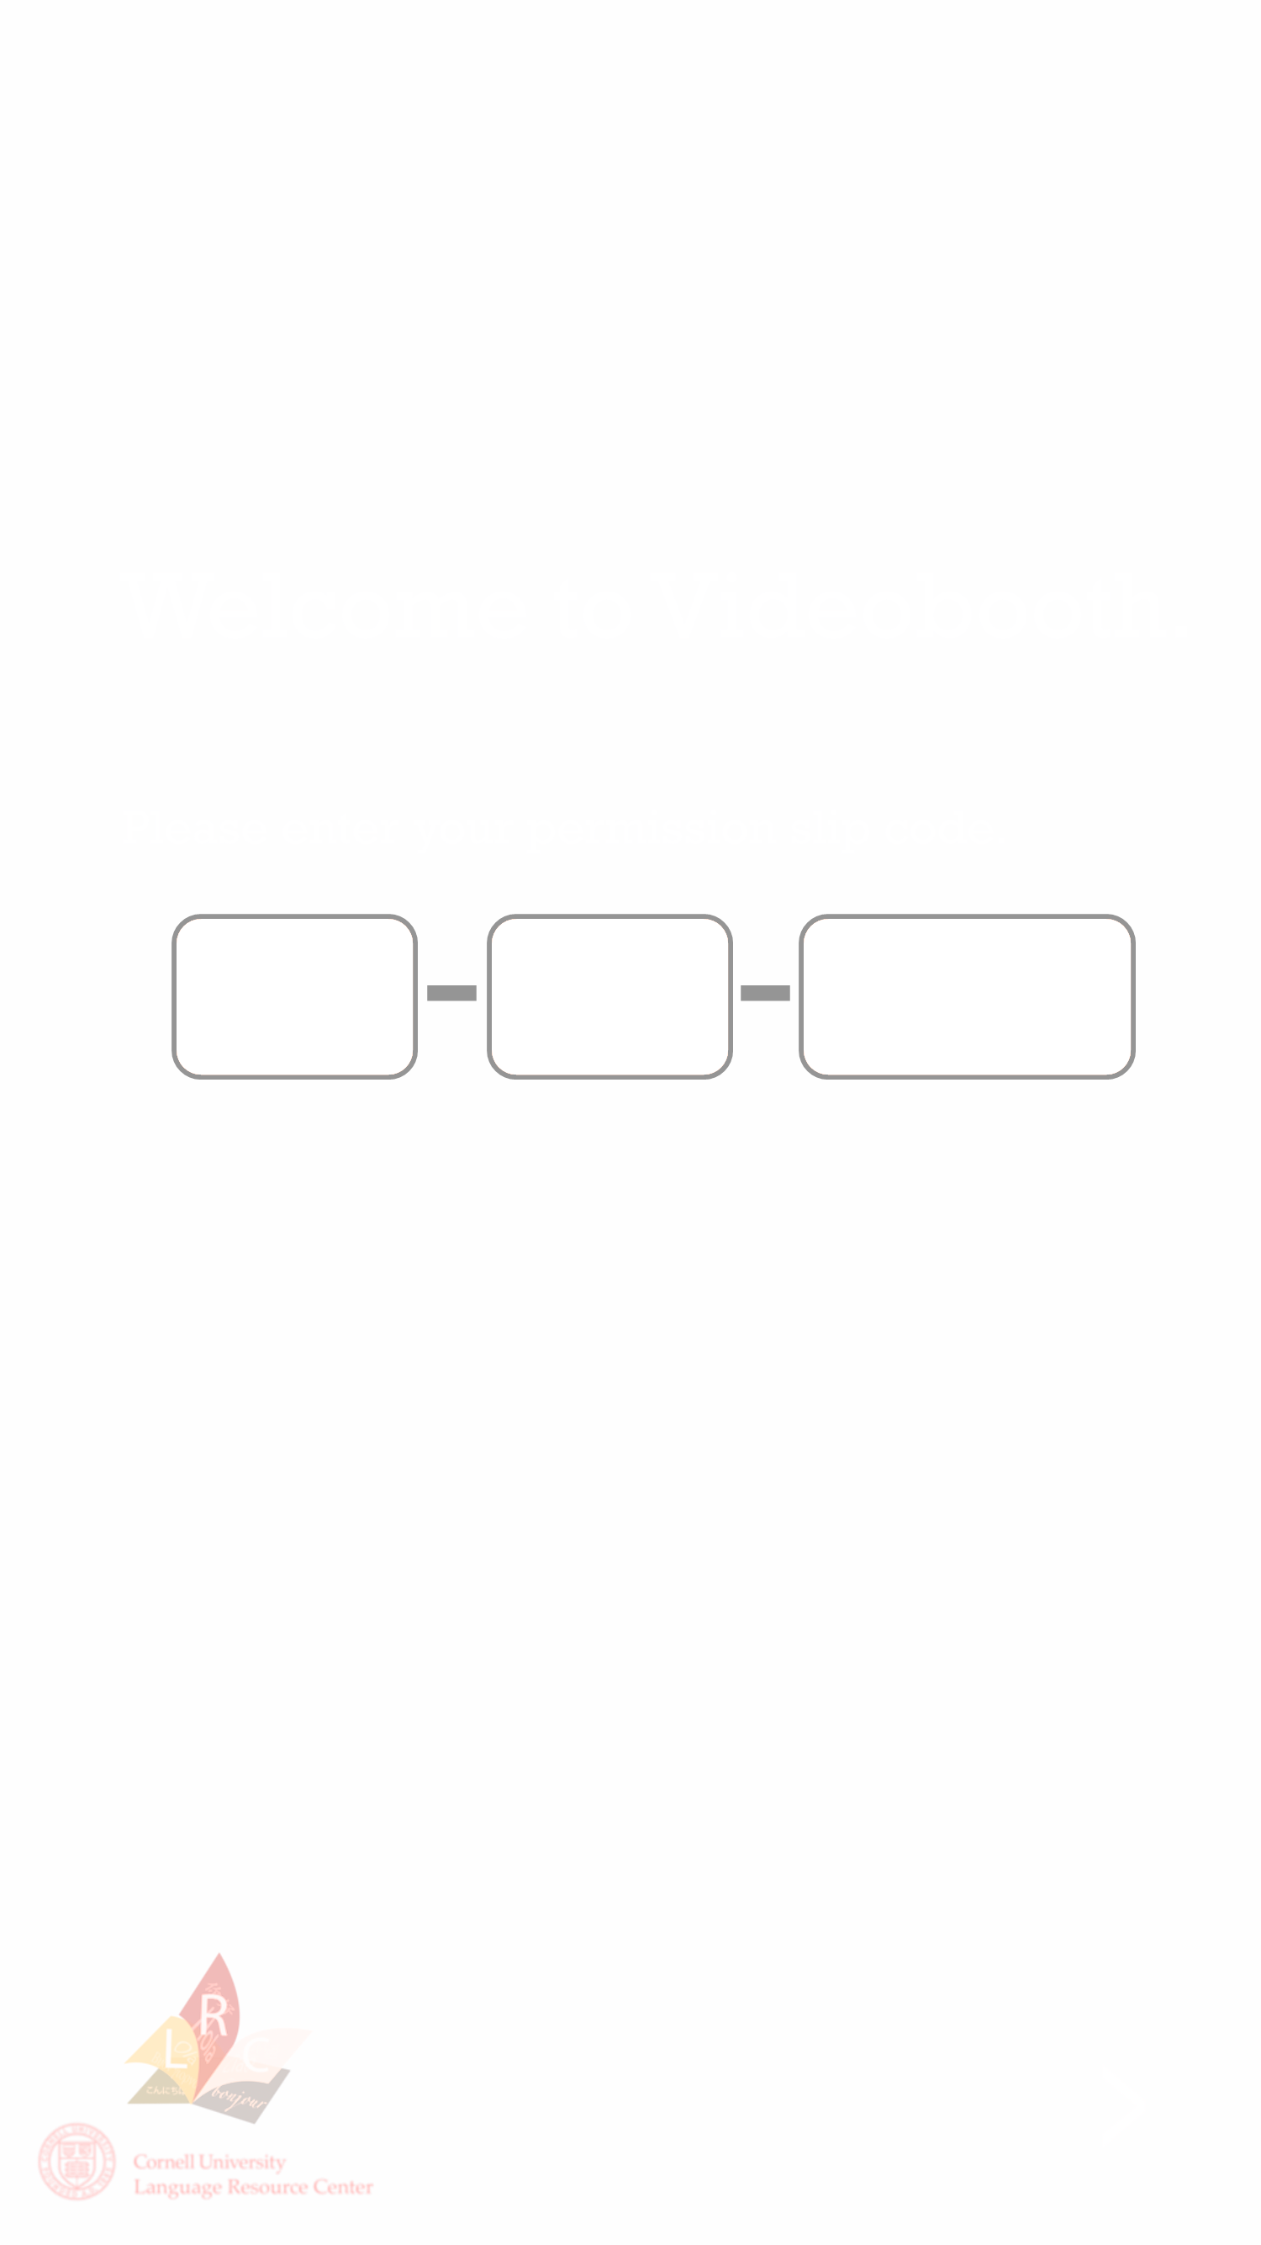
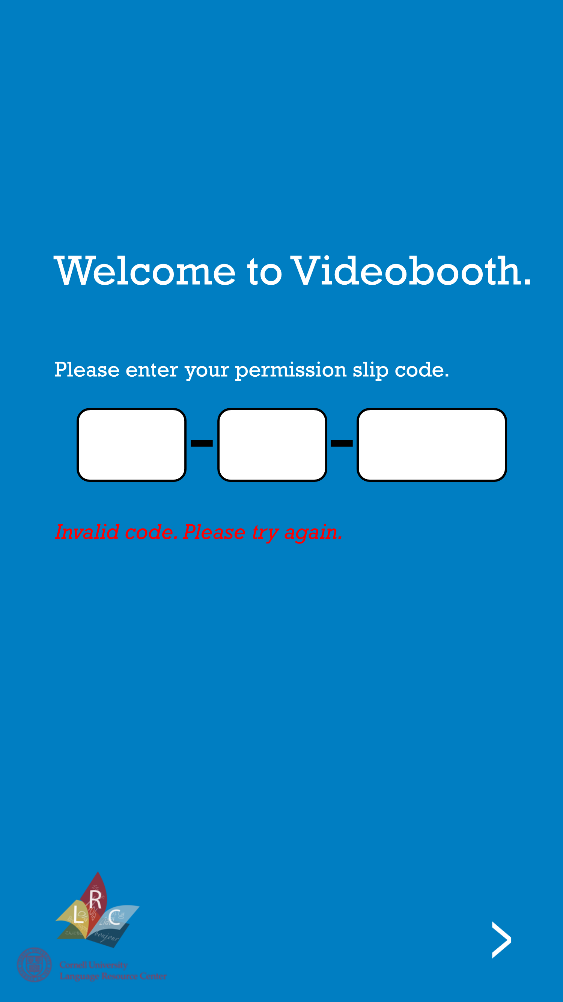
4. Incorrect Code
[Shake Animation]

Slide 6
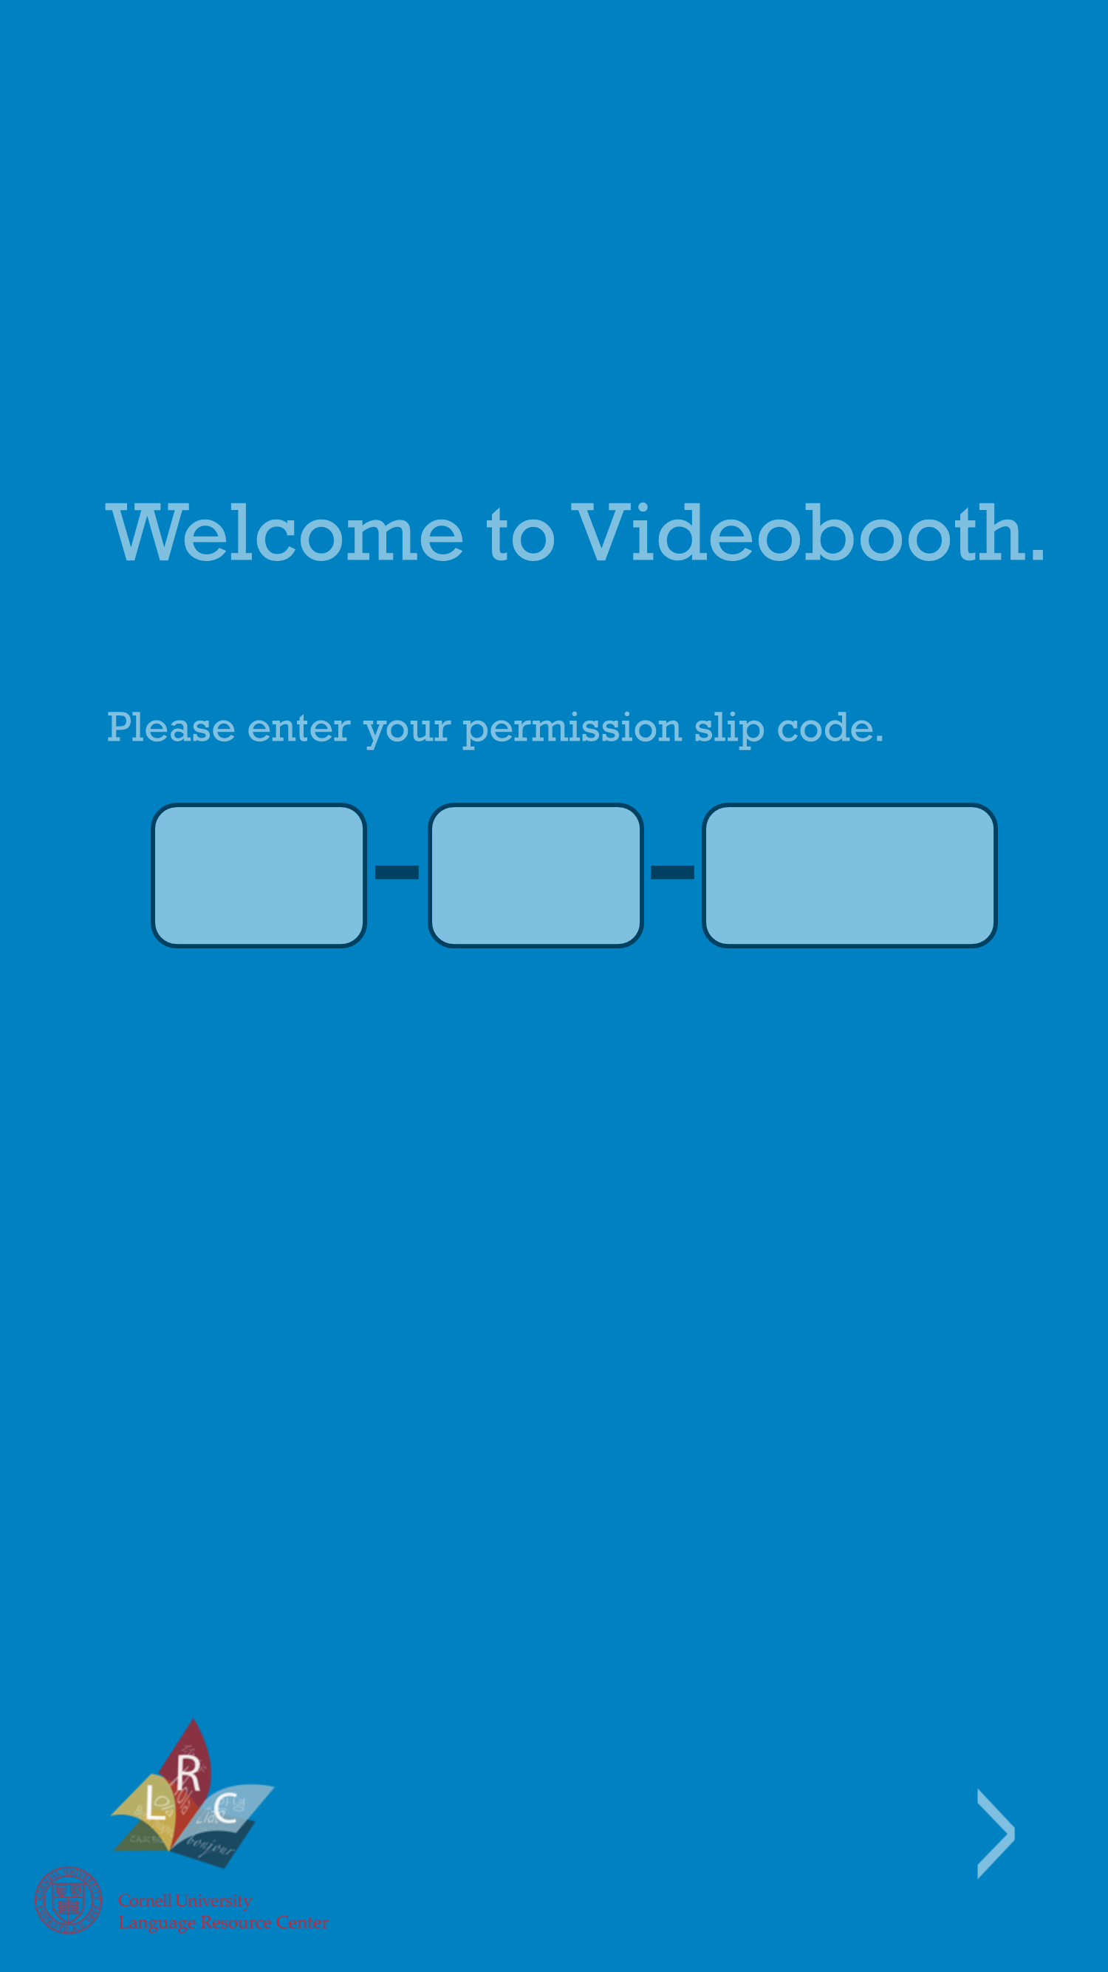

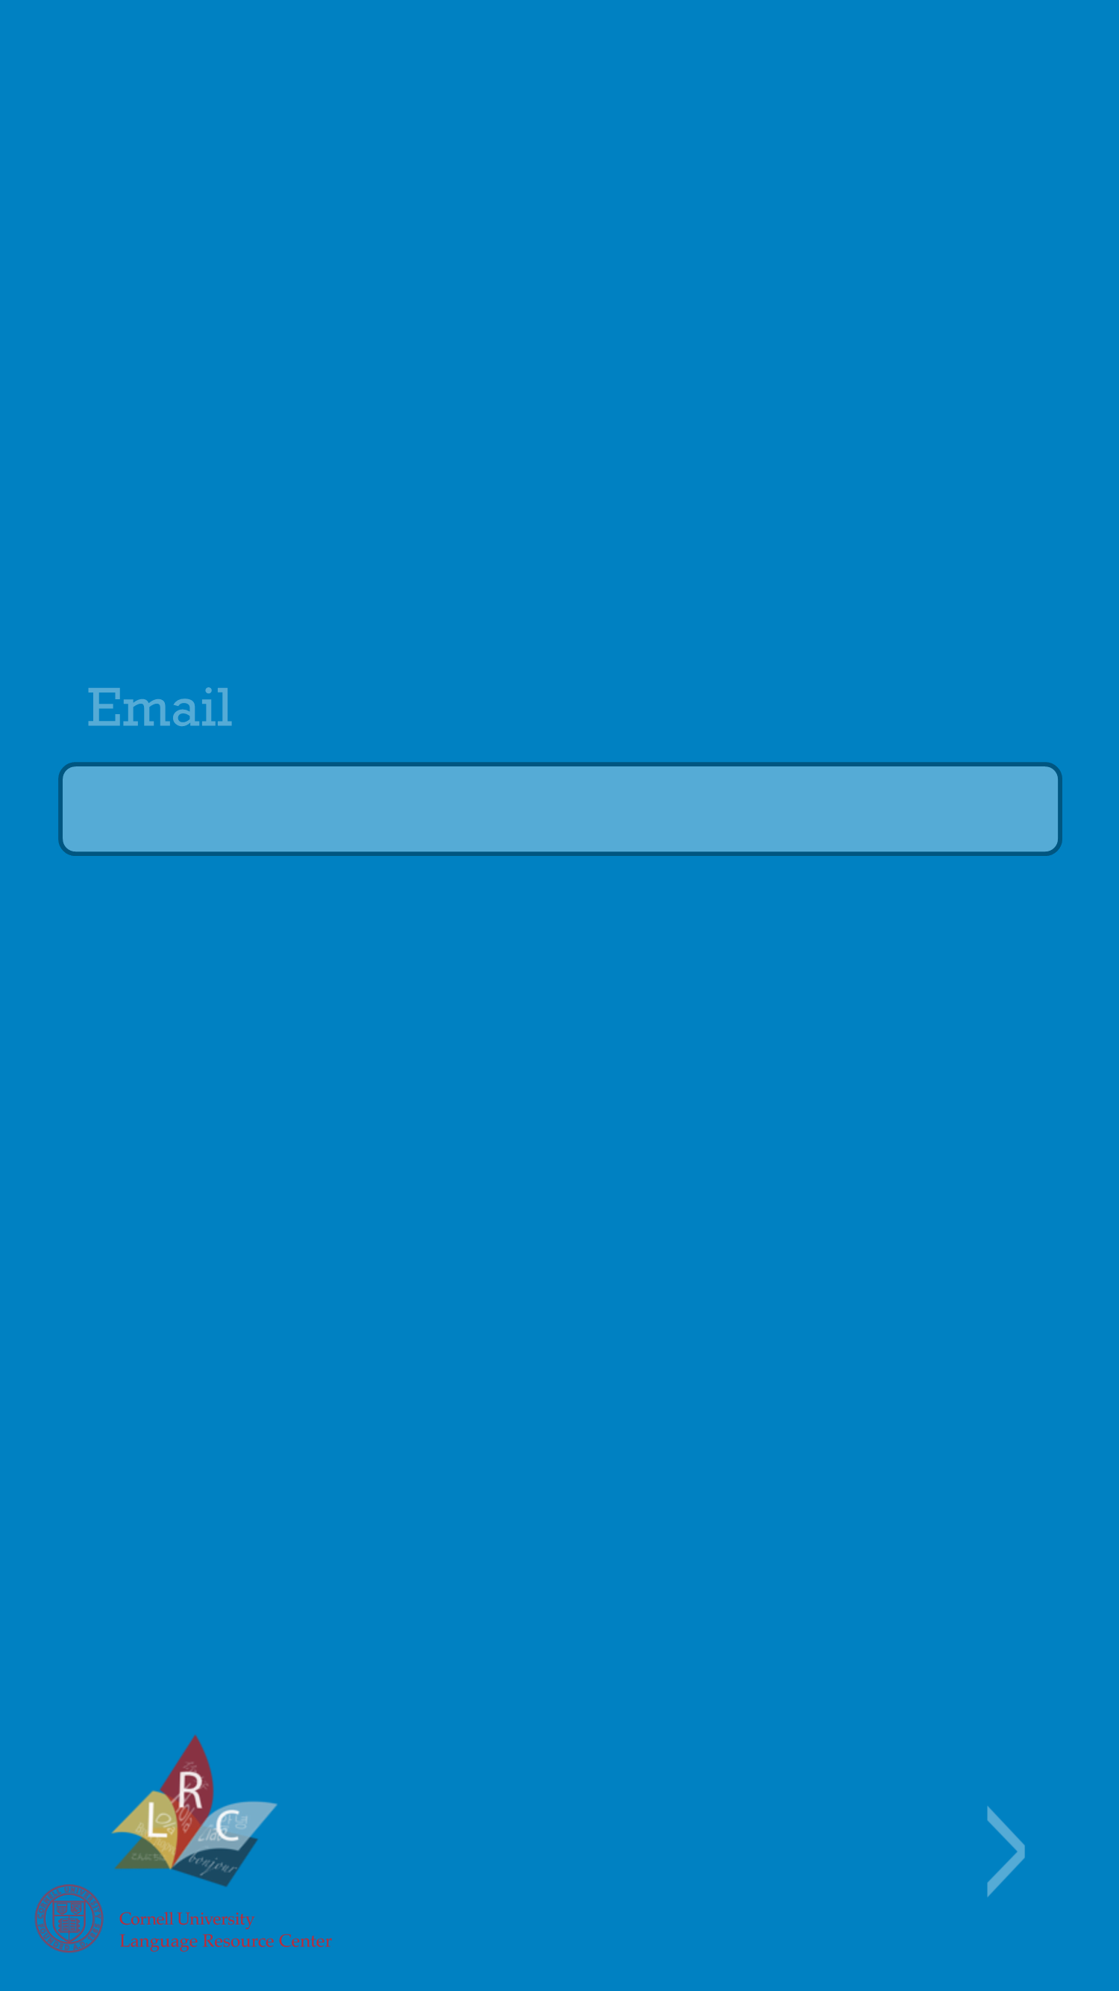
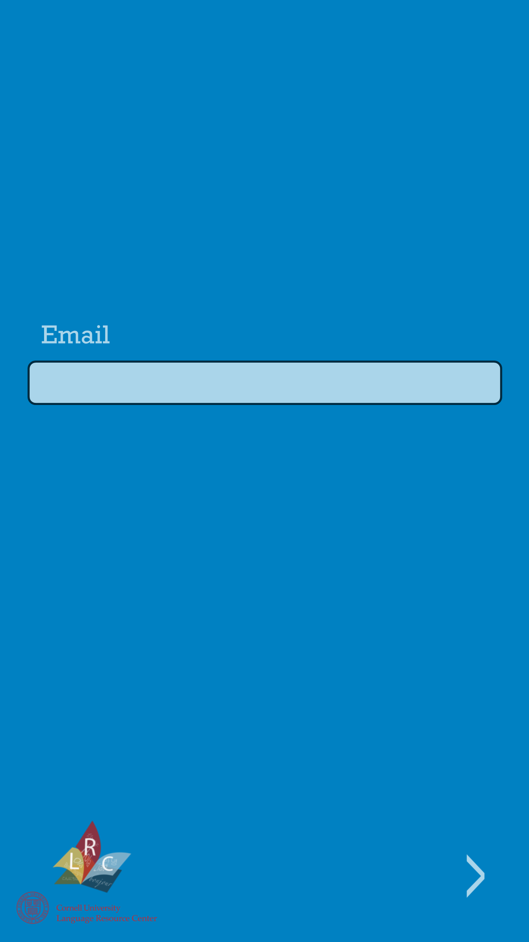
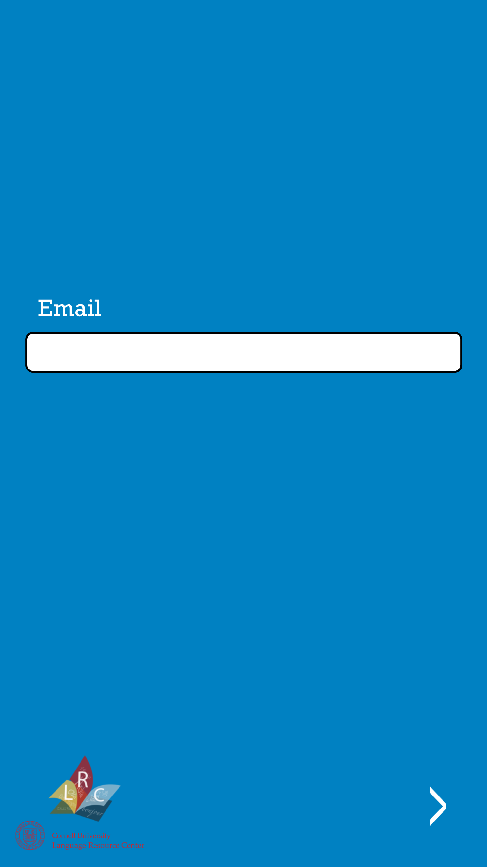
5. Valid Code
[Fade out]
[Pause]
[Fade in]
*** Notice: Logo doesn’t fade out. ***
Also, once the user enters their email, there should be a check on right format (@cornell.edu) and if the format is correct, a pop-up should appear asking the user to confirm their email was entered correctly.

Slide 7
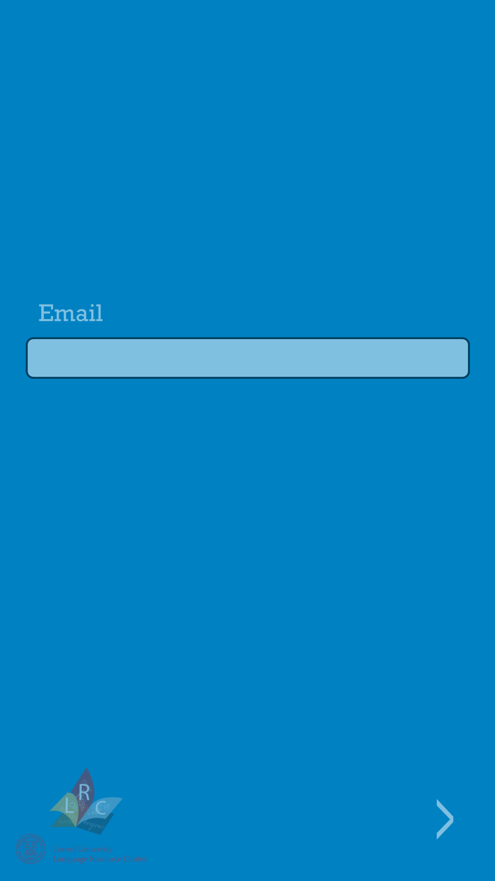




6. Fade Into Black Screen
[Fade out]
[Pause]
[Darken]

Slide 8
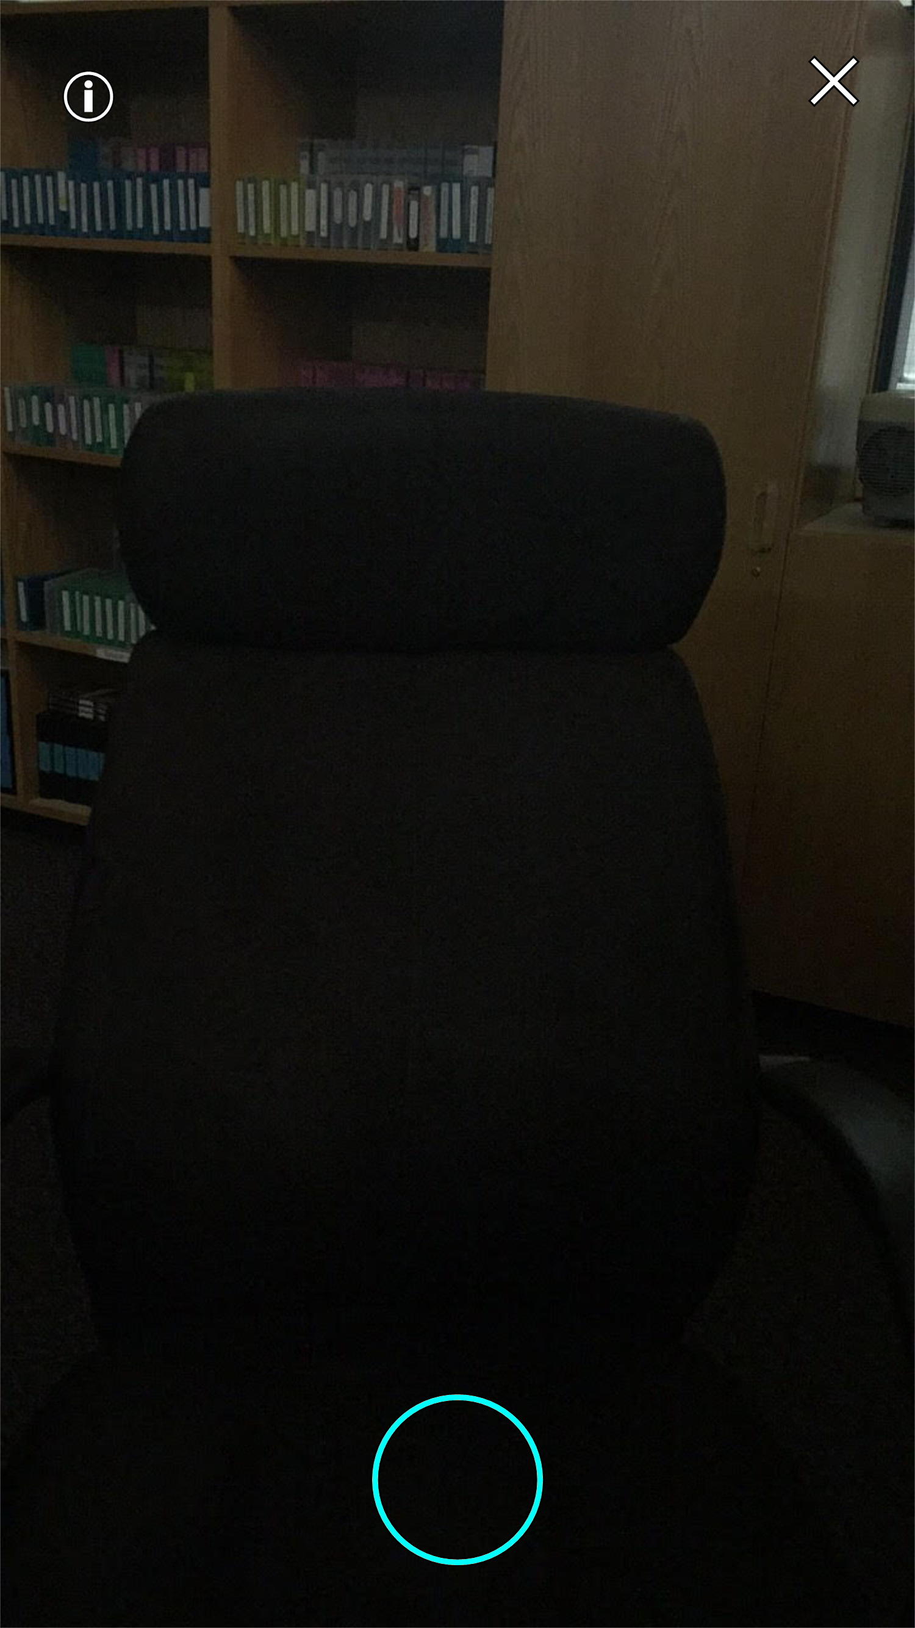
7. Camera resets/Turns on

Slide 9
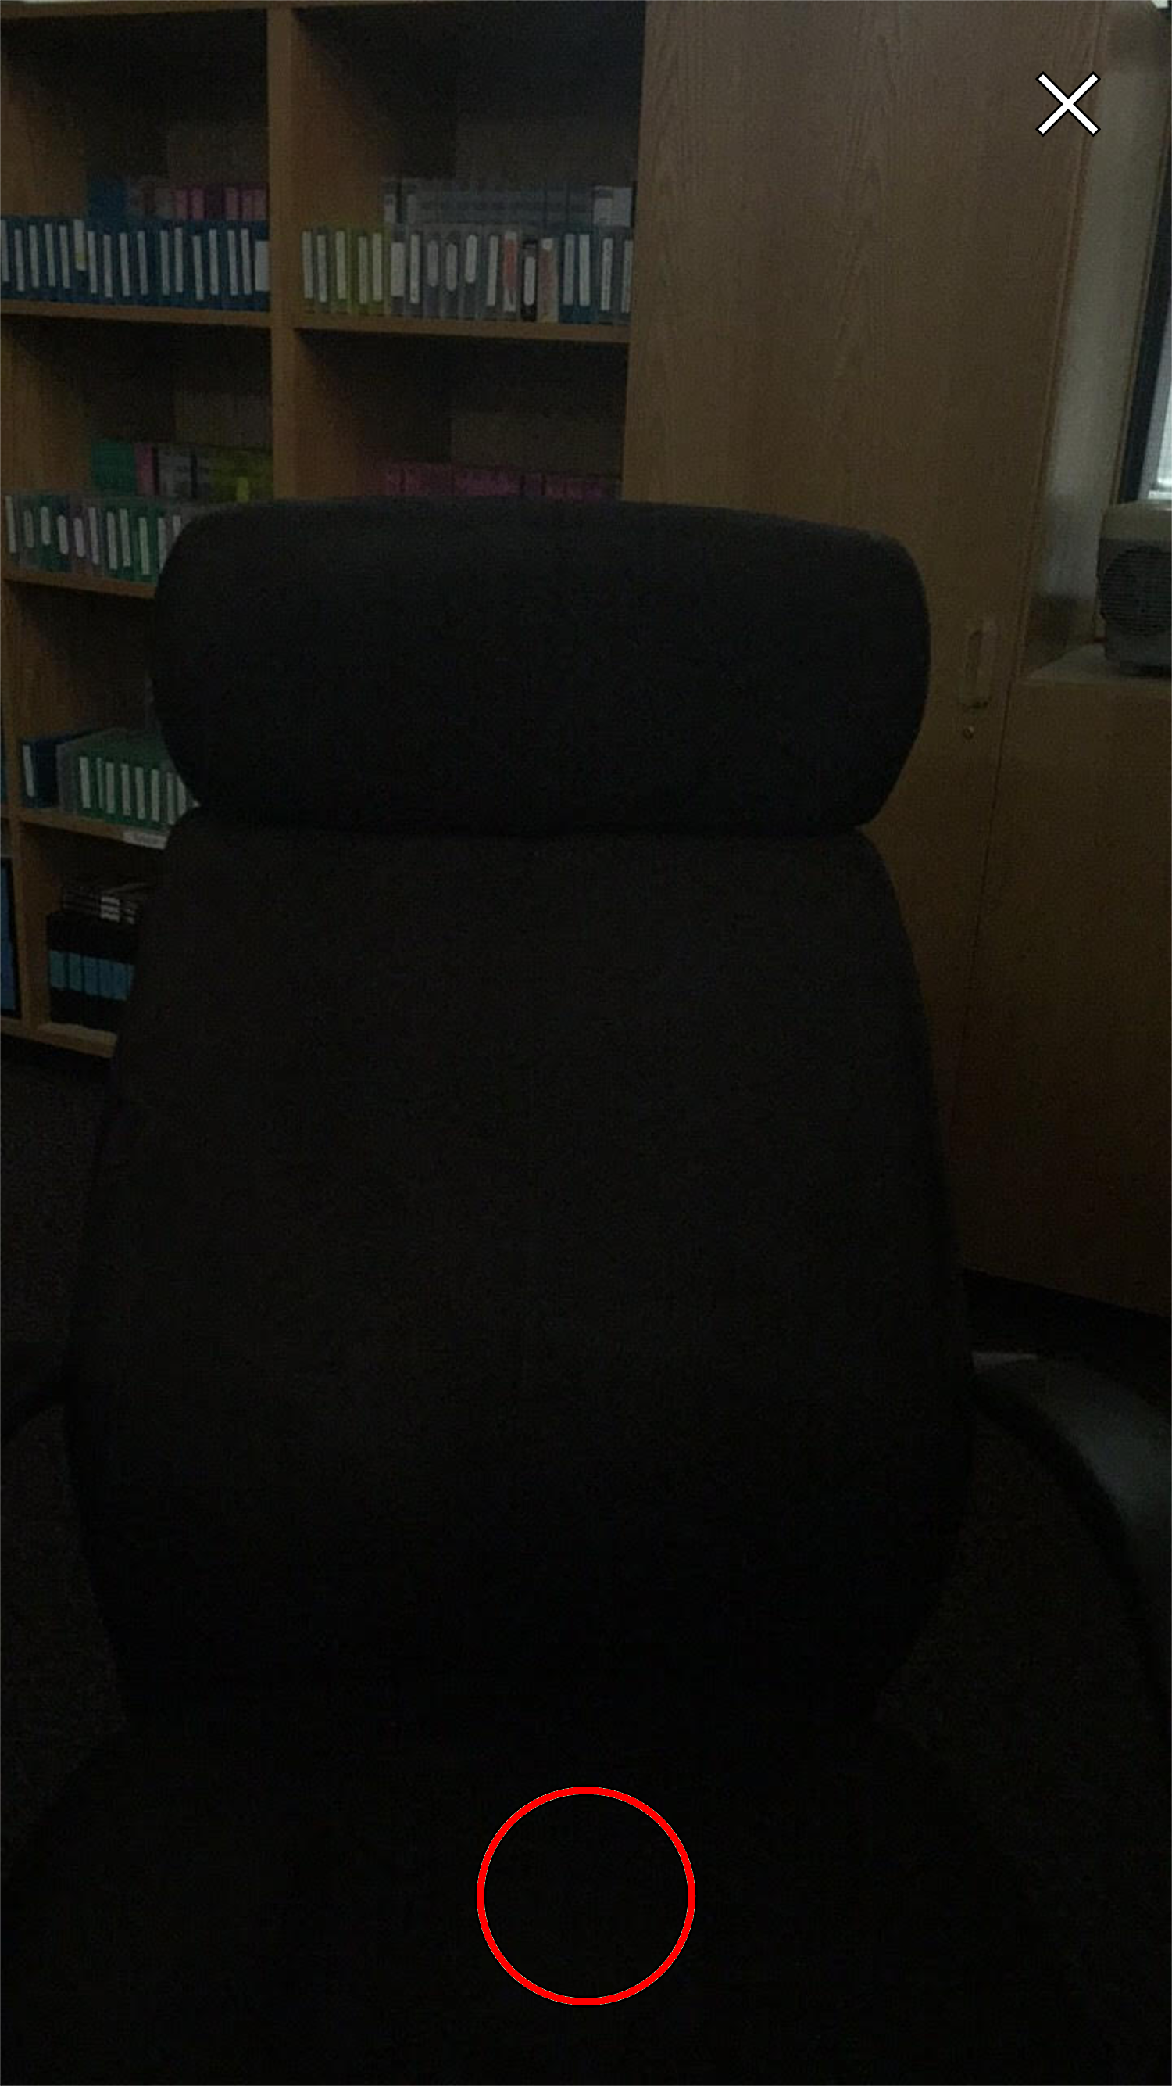
8. Recording Starts
If the X button is pressed before recording, the program will return to the beginning of the program, loading the program up again from scratch and resetting the user’s email input.
If the X button is pressed during recording, the program will return to the state in the left picture (blue button, waiting for the button to be pressed).
[Recording button is pressed/recording starts]
*** Notice: Information Button disappears and button turns red once button is pressed, indicating recording is in progress.
What the information button holds is TBD. ***

Slide 10
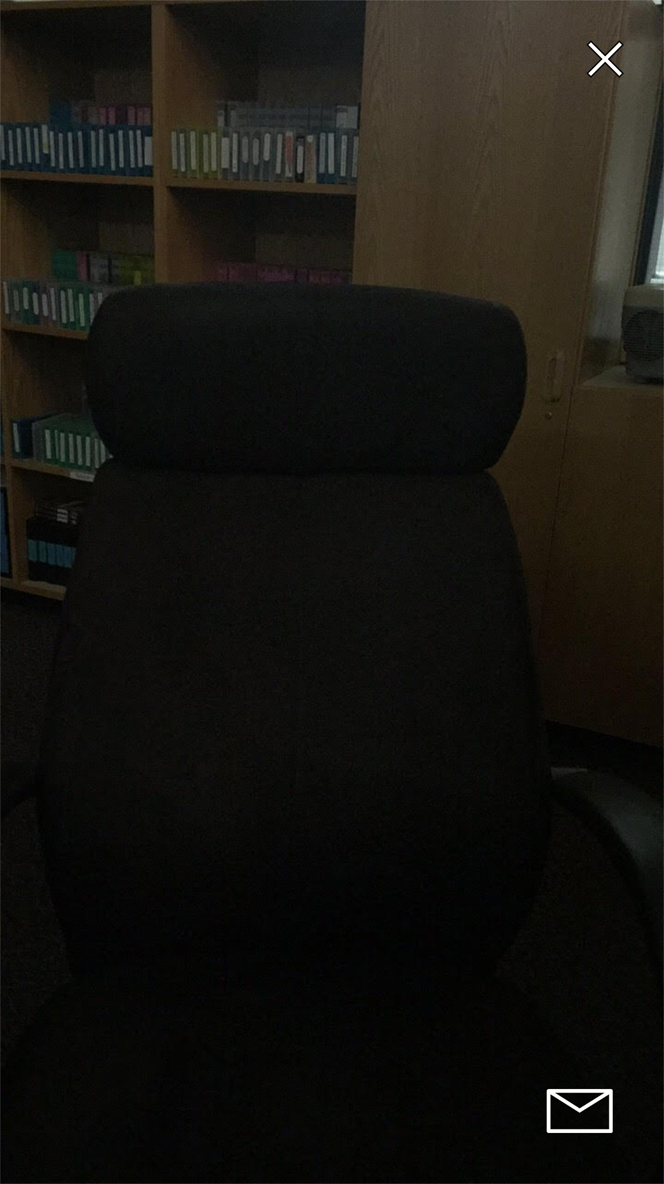
9. Playback/Mail out
If the X button is pressed during playback, there will first be a warning message, to prevent accidental deletion, asking the user if they’re sure they want to discard the video. If the user confirms, video will be discarded and program will return to Step 7 (Camera Resets/Turns On).
Pressing the Mail button will automatically send the video to the email entered by the user at the start of the program. The program will then return to Step 7 (Camera Resets/Turns On), allowing the user to record/send multiple videos during one session.
[Red Button Pressed/Recording Ends]
*** Notice: Pressing either the X button or the Mail button during this final stage will return the program to Step 7 (Camera Resets/Turns On). ***

